Slide 1
Mini project
Vitalijs Tickovs

Slide 2
Dataset

Slide 3
Dataset Interpretation
Variables describing weather
weathersit (4 distinct conditions)
temp (0 to 1)
atemp (0 to 1)
hum (0 to 1)
windspeed (0 to 1)
Variables describing time
- dteday date ( month/day/year)
- season (spring, summer, autums, winter)
- yr year (2011/2012)
- mnth (0 to 11)
- hr (0 to 23)
- holiday (0 or 1)
- weekday (0 to 6)
- workingday (0 or 1)
Target Variable Dependent Variables:
casual
registered
Target Variable:
cnt: casual + registered
Source: https://archive.ics.uci.edu/dataset/275/bike+sharing+dataset

Slide 4
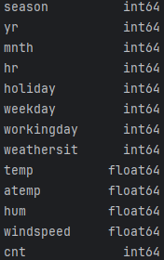
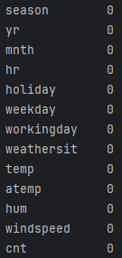
Dataset Cleaning
Size: 17377 entries
2 duplicate entries
Variable Type Table
NaN Value Table

Slide 5
Explanatory Data analysis

Slide 6
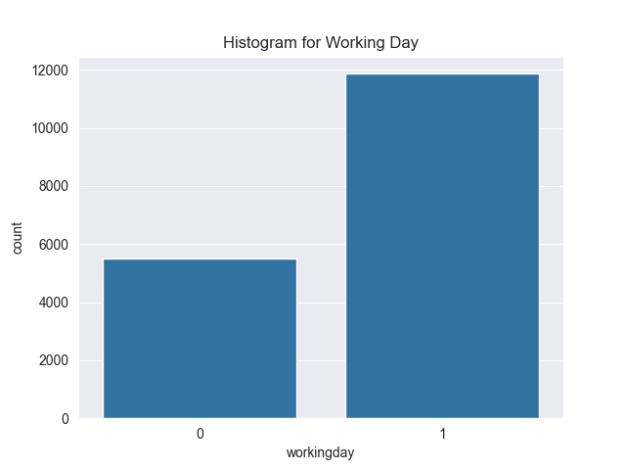
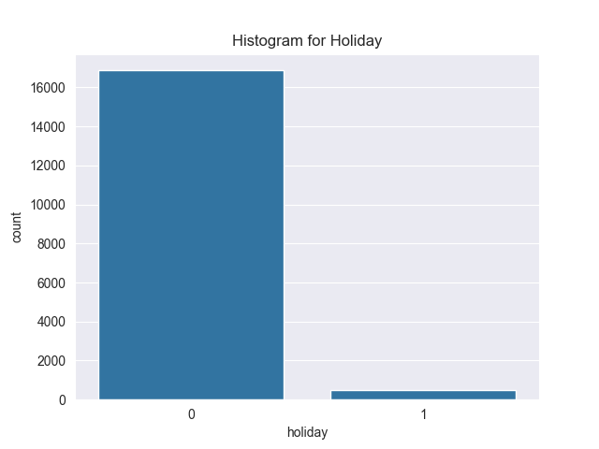
Histograms

Slide 7
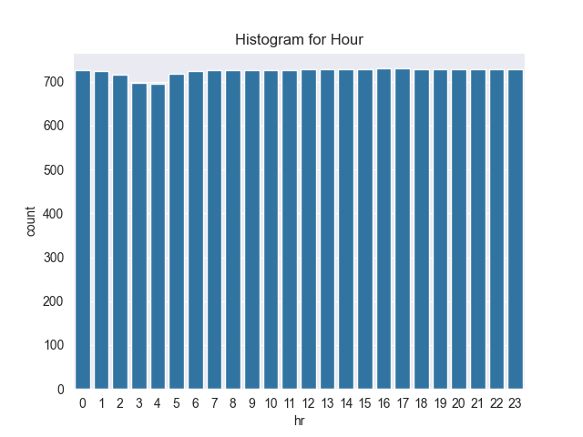
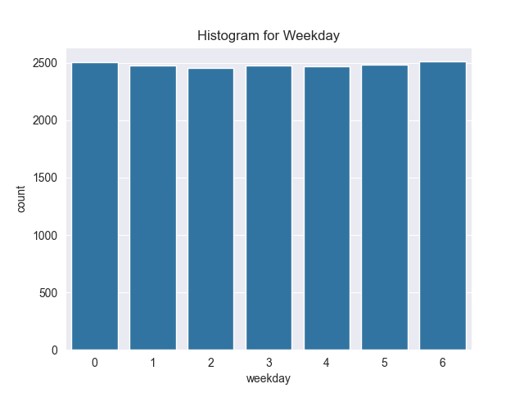
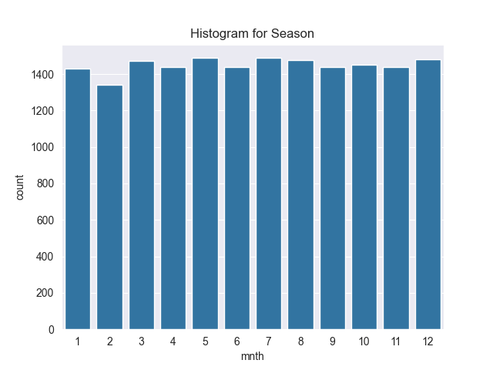
Histograms

Slide 8
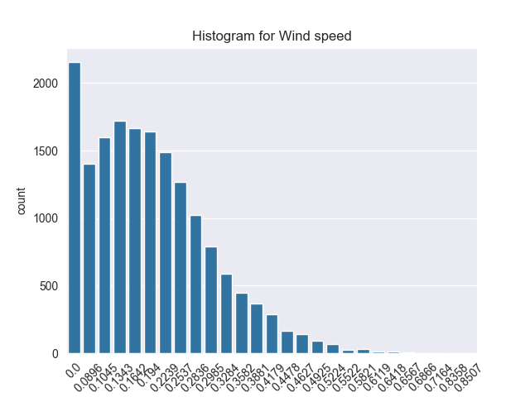
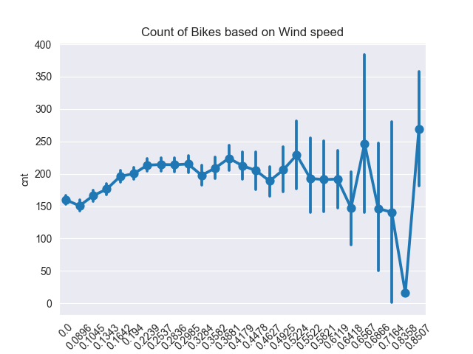
Windspeed plots

Slide 9
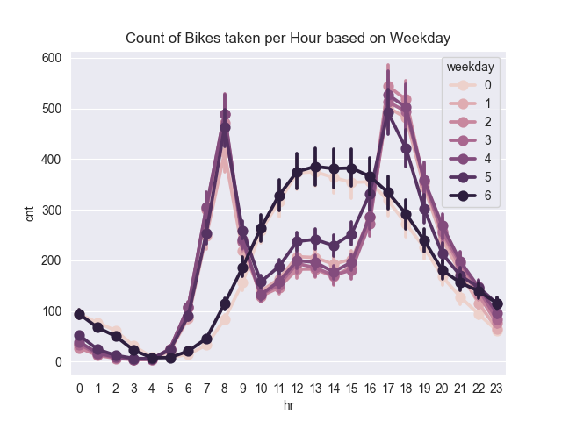
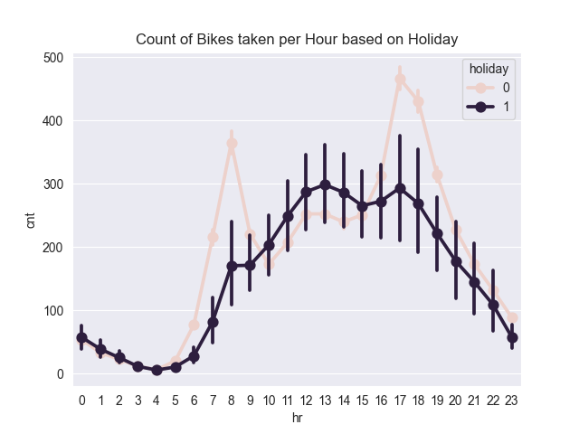
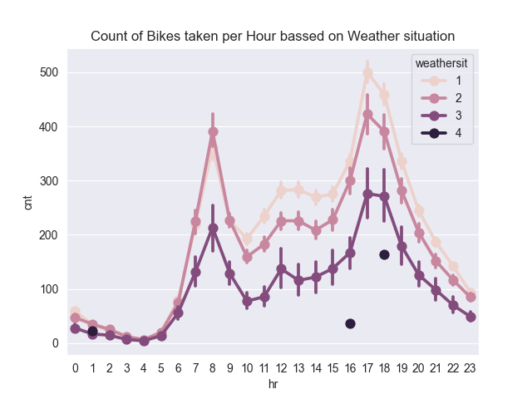
EDA

Slide 10
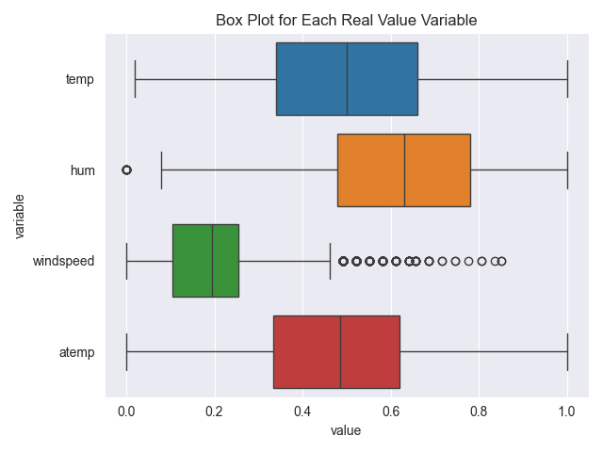

Boxplot

Slide 11
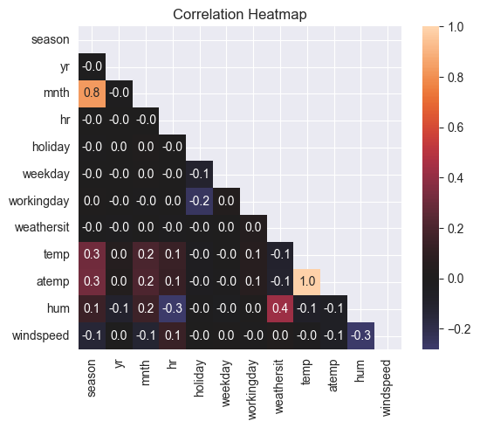
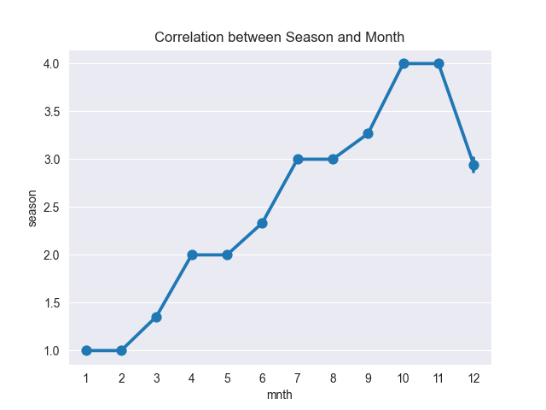
Correlation plots

Slide 12
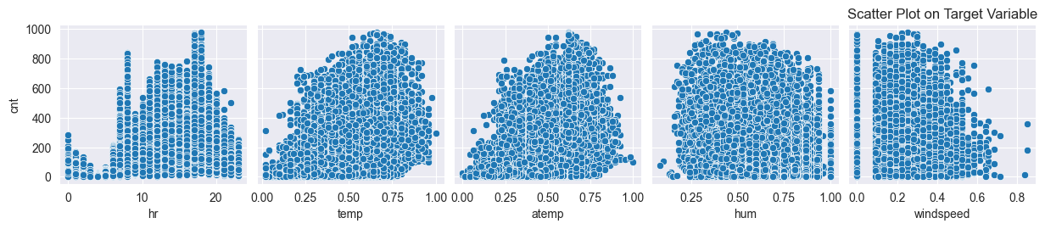
Target variable plot

Slide 13
Model

Slide 14
Model Types
DATASET SPLITTING
Linear Regression
Support Vector Machine
Random Forest
Neural Network
Train set: 80%
Test set: 20%
HYPERPARAMETER TUNUNG
GridSearchCV

Slide 15
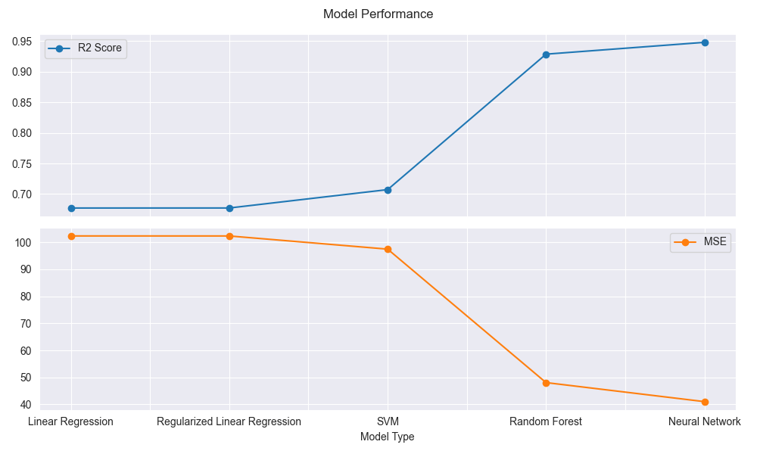
Model comparison

Slide 16
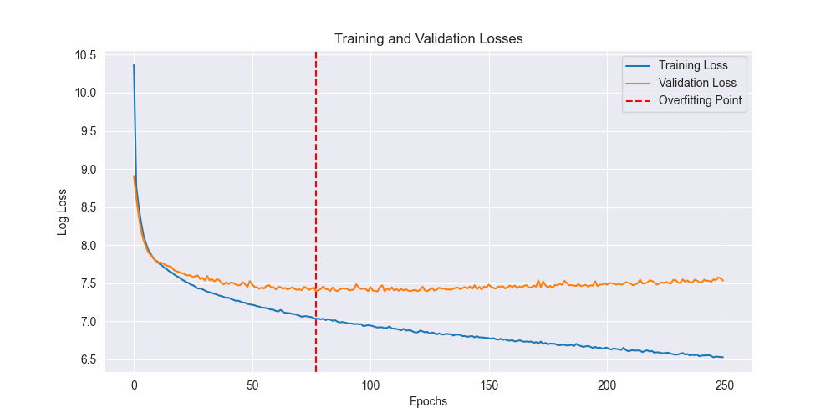
Neural network overfitting plot

Slide 17
Another task completed

Slide 18
Tasks completed
mlcourse.ai lectures + assignments:
Unsupervised Learning(DBSCAN)
Feature Engineering + Feature Selection
Regularization
Time series
Deep learning courses:
RNN
LSTM
QQ plots
Loss function vs Cost function
Task from Olena’s project

Slide 19
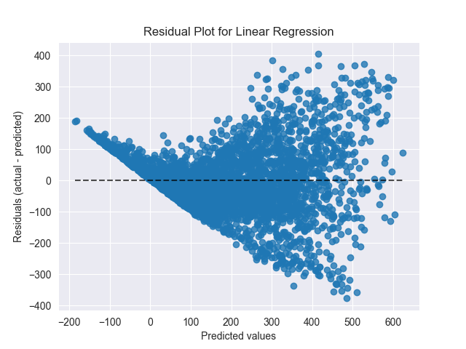
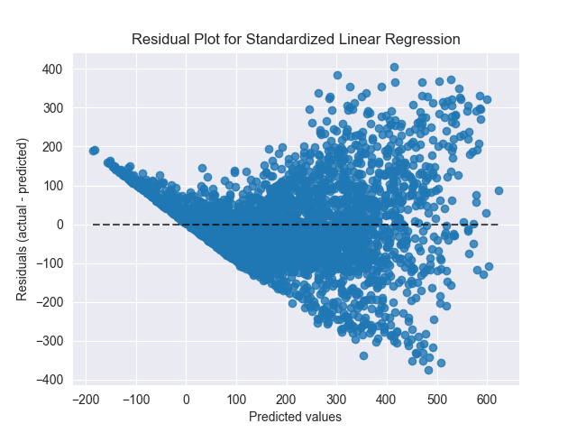

Residual Plots(Linear Regression)

Slide 20
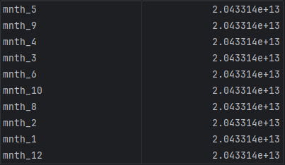
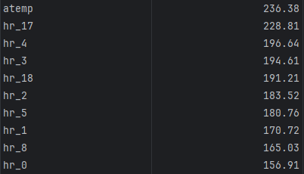
Coefficients of Linear regression
Linear Regression
Regularized Linear Regression

Slide 21
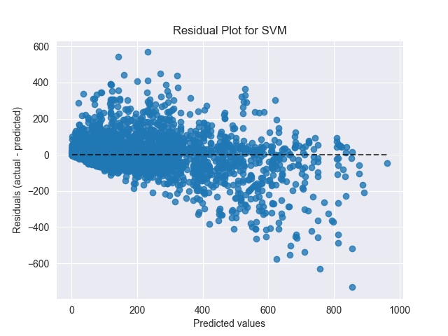
Residual Plots(SVM)

Slide 22
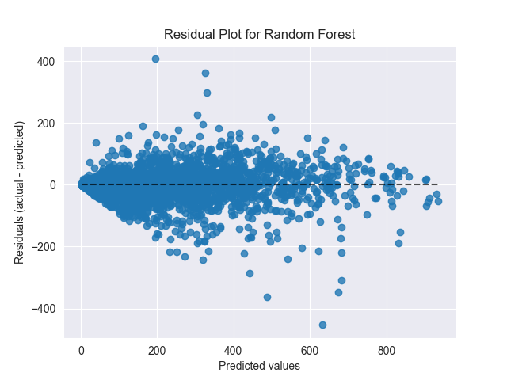
Residual Plots(Random Forest)

Slide 23
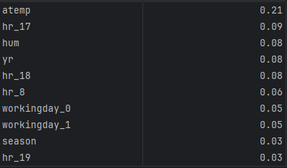
Coefficients of Random Forest

Slide 24
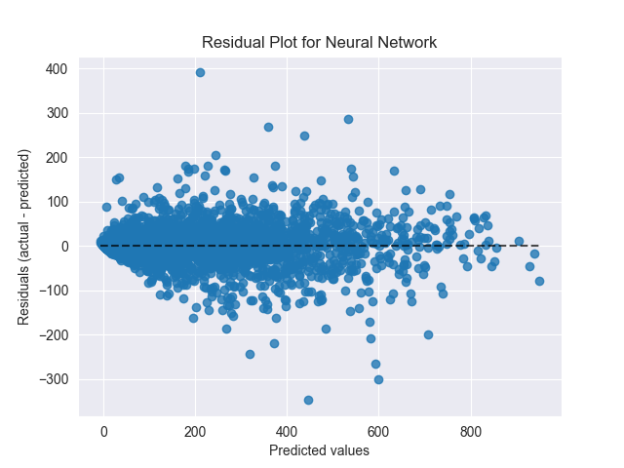
Residual Plots(Neural network)

